Slide 1

CHECKID
PRODUCT OVERVIEW
Verify the RFID chip with NFC

Slide 2






CONTENTS
Introduction
Features & Benefits
Verification & Supported
Use cases & Identification Terminal
Why CheckID?

Slide 3
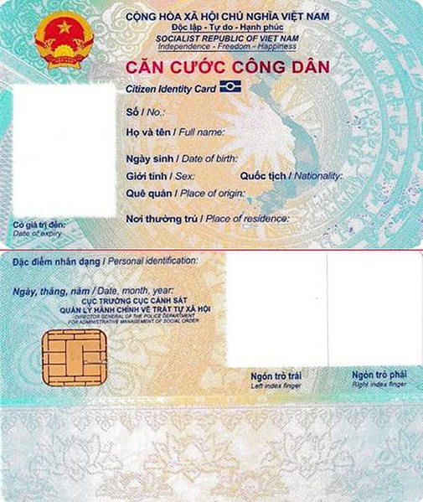
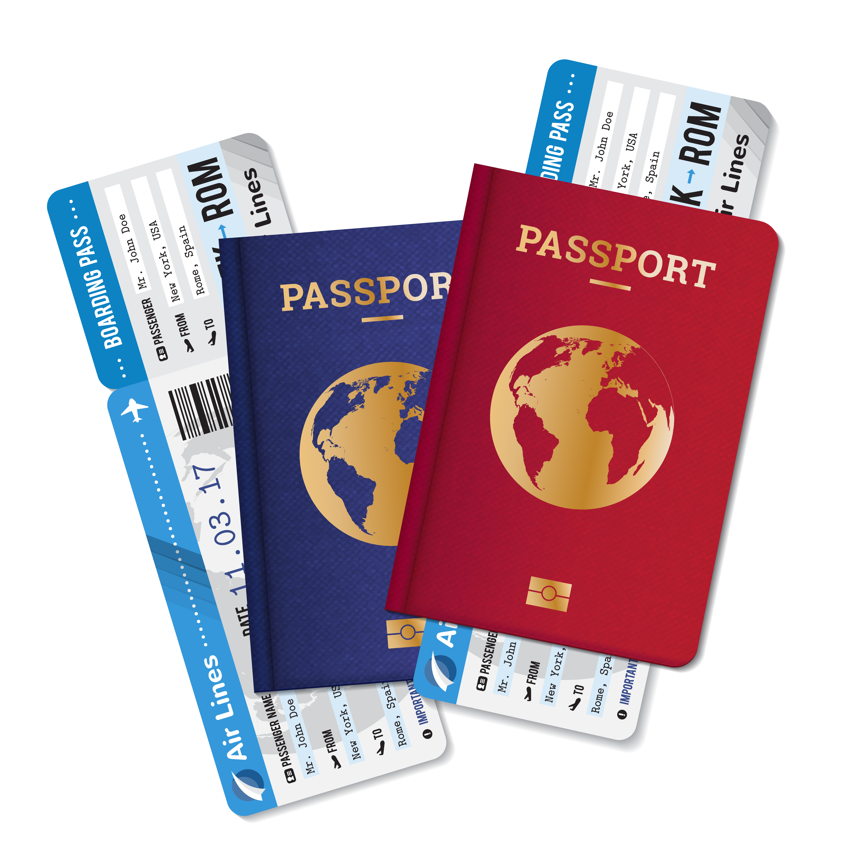
INTRODUCTION
Many passports, identity cards and other identity documents contain a contactless (RFID) chip.
The chip contains reliable personal information about the holder, including the full name, date of birth and nationality, a high-resolution face image, suitable for face recognition.
About
CheckID
Verifying people’s identity is essential in preventing identity fraud and enabling trustworthy digital services. CheckID is the first and leading solution for verifying identity documents using smartphones’ NFC. The combination of identity documents with contactless chips and NFC-capable smartphones is the cornerstone of CheckID

Slide 4
CHECKID FEATURES
Read personal information from the chip
Establish authenticity of identity documents
Access to high resolution face image on chip
Use CheckID Optical Character Recognition to scan QR and interpret the text for processing
Integrate the CheckID SDK’s into your own app through APIs and create a smooth experience
Provide a ready-to-use app called CheckID
Available as SaaS, Client-only
QR and NFC functionality can be licensed separately

Slide 5
CHECKID BENEFITS
Unrivalled reliability of verification
Straight-through processing, with the retrieved data
from the chip available as signed pdf, XML or JSON
without manual backend processes
Data extraction without Optical Character Recognition (OCR) errors or manual typing mistakes
Look-a-like fraud prevention, because of the high-resolution face image that is retrieved from the chip
The chips have protection against cloning, which is based on the highest standards of cryptography

Slide 6
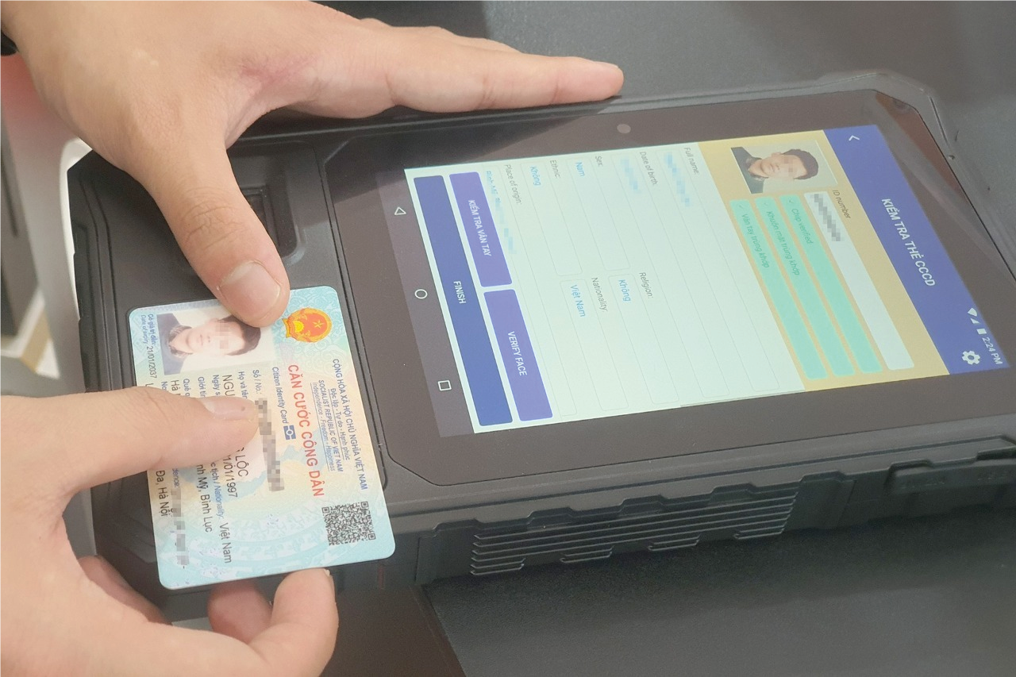
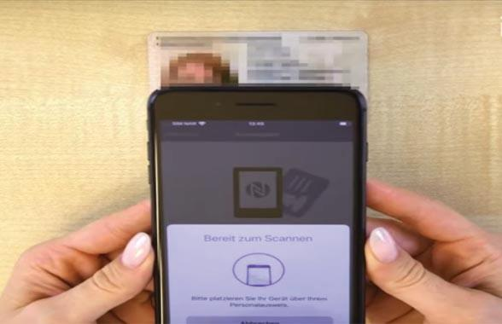
IDENTITY DOCUMENT VERIFICATION
1
Scanning the Quick Response
The user first scans the QR in the identity document with the smartphone’s camera
The QR contains the password to open the chip and preventing unauthorized access
2
Reading the chip
Holds the identity document to the back of the smartphone, allowing the chip to be read by NFC
CheckID reads the chipcontents, extracts the document’s data and verifies the authenticity of the personal information from the chip

Slide 7


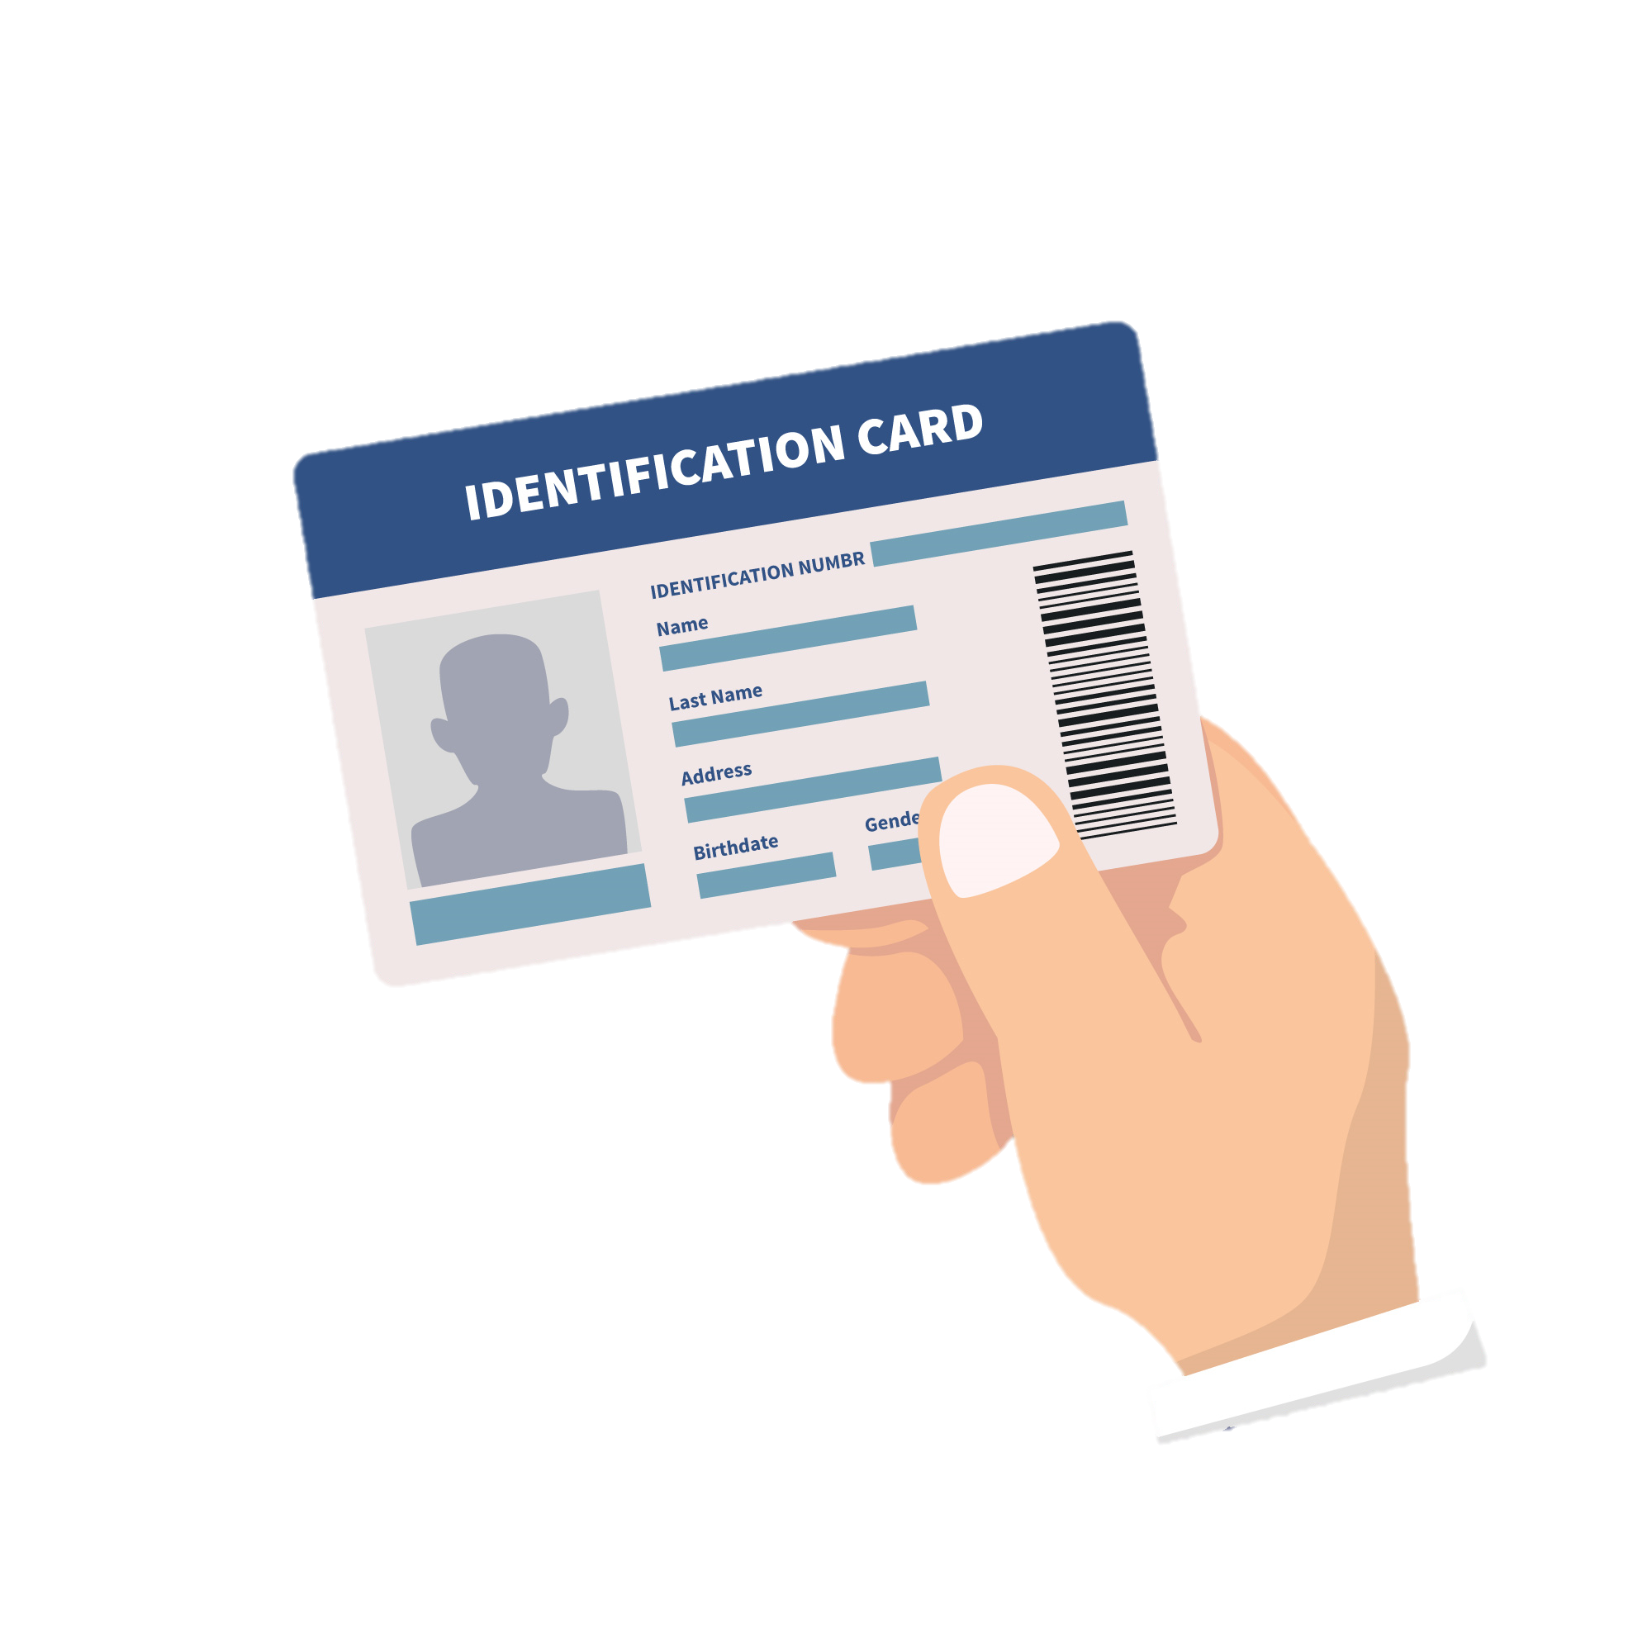

IDENTITY DOCUMENTS SUPPORTED
Supports identity documents that have ICAO 9303 compliant chips
ICAO is the UN organization that standardizes passports
Passports, (depending on the country) national identity cards and residence cards

Slide 8

IDENTITY DOCUMENTS SUPPORTED
Supports the Vietnamese eID card
Works with identity documents from over 100 countries, including all countries from the Australia, New Zealand

Slide 9


USE CASES
ONLINE
Users verify their own identity using their smartphone, typically as part of a self service online onboarding process
CheckID customers: Vietnam Government Certification Authority, Public Certification Authorities and some specific banks
FACE TO FACE
The verification is executed by an employee who has physical access to the identity document, typically as part of an identity verification in presence of the user
CheckID customers: a bank employee, police officer or border control agent

Slide 10
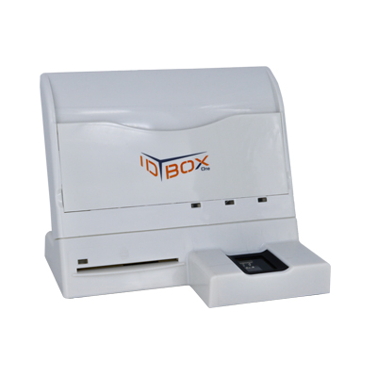
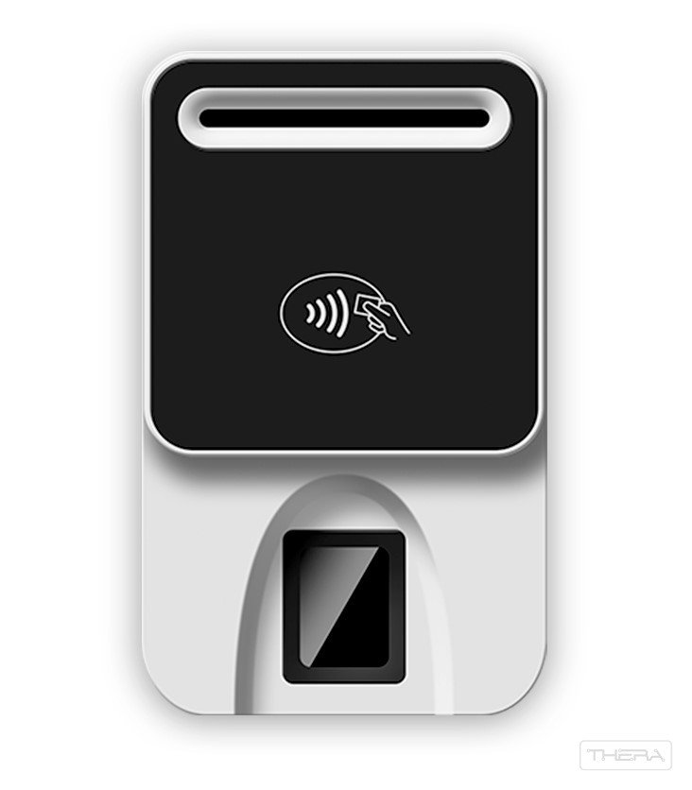
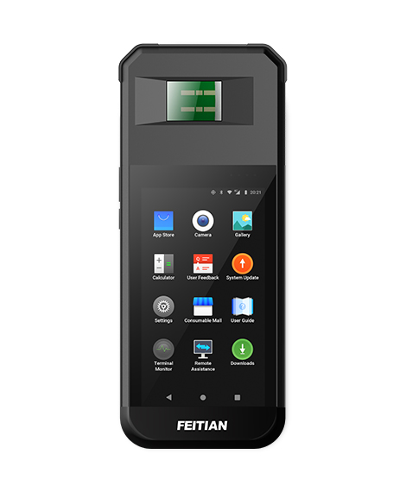
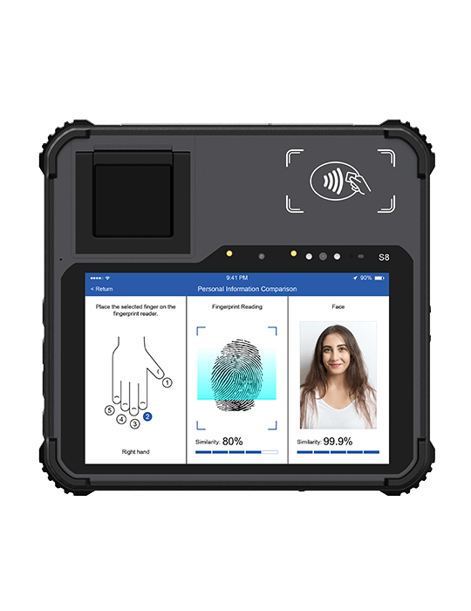


IDENTIFICATION TERMINAL
ID BOX One 152
BioR502
V10P Android POS
S8 Android Tablet
From iOS 13
From Android 5.0

Slide 11
Why CheckID?
Your app, CheckID inside
User Friendly
Face verification
CheckID SaaS is integrated in your app using our CheckID SDK, following your look & feel. It is CheckID inside
It is reliable and user-friendly, much more than optical scanning of identity documents or online video identification
Orchestration with facematch and liveness for holder verification is possible to create the best identy verification solution available
Scalable and secure
Instant results
Privacy committed
Host CheckID SaaS in a highly secure public cloud. Secure and highly scalable
Get the personal information and verification results instantly, via a RESTful
interface (JSON, XML or PDF)
Committed to your security and your customers’ privacy

Slide 12





Thanks for watching!
MOBILE-ID TECHNOLOGIES & SERVICES JOINT STOCK COMPANY
Level 9, Thuy Loi 4 Building, 286-288 Nguyen Xi street, Ward 13, Binh Thanh District, HCM City
028 3622 2982
info@mobile-id.vn

